Slide 1
Animation
Computer animation is the art of creating moving images via the use of computers.
It is a subfield of computer graphics and animation.
Animation refers to the movement on the screen of the display device created by displaying a sequence of still images.
Animation is the technique of designing, drawing, making layouts and preparation of photographic series which are integrated into the multimedia and gaming products.
A person who creates animations is called animator.
He/she use various computer technologies to capture the pictures and then to animate these in the desired sequence.

Slide 2
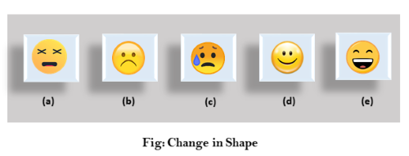
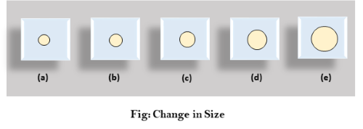
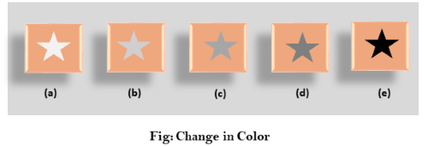
Change of shape as shown in fig:
2. Change in size as shown in fig:
3. Change in color as shown in fig:

Slide 3
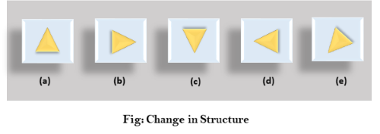
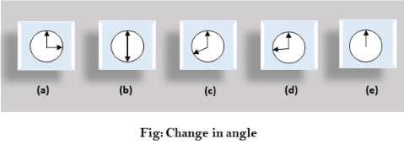
4. Change in structure as shown in fig:
5. Change in angle as shown in fig:

Slide 4
Animation techniques
Conventional animation
Computer based animation

Slide 5
Conventional animation
Storyboard
With the help of sequence of sketches the structure animation is created. this outline is called as ‘storyboard’.
b. Key Frames
These are the key entities which are used in animation.
c. In-between
Once the key-frames of the animation are drawn, the intermediate position can be inferred. Filled the intermediate frames in key-frames is called as ‘in-between’
d. Pencil test
With key-frames and in-between a trial film is made,which is called as ‘pencil-test’

Slide 6
e. cells-
A common technique is to dcompose an animation picture into several parts that can move more or less independently.
e. Route sheet
The sheet which describes each scene and the people responsible for the various aspects of the producing the sense is called ‘route-sheet’
f. Exposure sheet
The sheet which gives the detailed description of an animation is called as an ‘exposure-sheet’.

Slide 7
Steps in design of animation sequence
The story of animation is written and storyboard is created
If any sound track is to be recorded, according to the drawing for every scenes in the animation, a detailed layout is produces.
The instants at which significant sounds occur are recorded in order. Then the detailed layout and the sound track are correlated.
Certain key-frames of the animation are drawn.
With key-frames and in-between , pencil test frames are obtained.
The pencil test frames are then transferred to cells.
The cells are colored in or painted and are arranged in a correct sequence. Then they are filmed.
Since this animation uses key-frames and in-between , so it is called as ‘key-frame animation’.

Slide 8
Computer Based Animation
Computer animation can be created with a computer and animation software.
Examples: art of illusion, 3D studio max, Adobe flash
This software provides basic functions to create an animation and to process individual objects.
Steps needed in computer animation
Digitization
Composition
In-between frames
Equivalent of pencil test

Slide 9
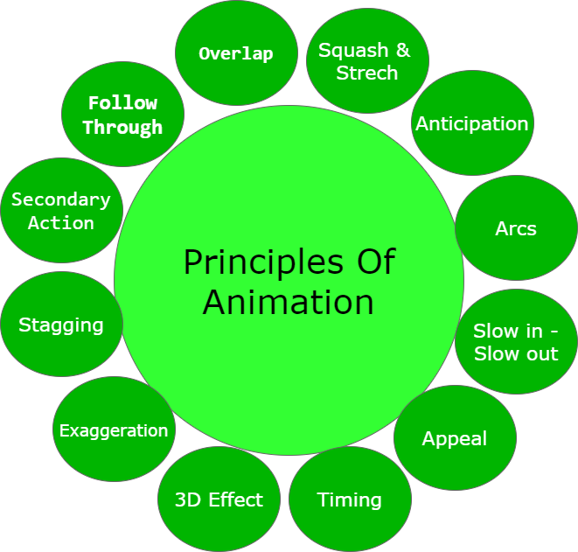
Principles of animation

Slide 10
Squash and Stretch: This principle works over the physical properties that are expected to change in any process. Ensuring proper squash and stretch makes our animation more convincing.
For Example: When we drop a ball from height, there is a change in its physical property. When the ball touches the surface, it bends slightly which should be depicted in animation properly.
Anticipation
In Anticipation, we make our audience prepare for action. It helps to make our animation look more realistic
Arcs: In Reality, humans and animals move in arcs. Introducing the concept of arcs will increase the realism. This principle of animation helps us to implement the realism through projectile motion also.

Slide 11
Slow in-Slow out: While performing animation, one should always keep in mind that in reality object takes time to accelerate and slow down.
To make our animation look realistic, we should always focus on its slow in and slow out proportion.
Appeal: Animation should be appealing to the audience and must be easy to understand.
The syntax or font style used should be easily understood and appealing to the audience.
Timing
Velocity with which object is moving effects animation a lot. The speed should be handled with care in case of animation.

Slide 12
3D Effect: By giving 3D effects we can make our animation more convincing and effective.
Exaggeration: Exaggeration deals with the physical features and emotions. In Animation, we represent emotions and feeling in exaggerated form to make it more realistic.
Stagging: Stagging is defined as the presentation of the primary idea, mood or action. It should always be in presentable and easy to manner.
Secondary Action: Secondary actions are more important than primary action as they represent the animation as a whole. Secondary actions support the primary or main idea

Slide 13
Follow Through: It refers to the action which continues to move even after the completion of action. This type of action helps in the generation of more idealistic animations.
Overlap: It deals with the nature in which before ending the first action, the second action starts.

Slide 14
Rules required for animation
Illustration animation
Use this animations that have a single interpretation. They should have little value if confusing.
Show one thing at a time to avoid confusion
2. Effect animation
Use effect animation for objects that the user is currently interacting with .
Such animations aren’t distracting beacause the the user is already focused on the object.
3. Relationship animation
Must start or end with the selected object. don’t show relationships between objects that the user isn’t currently interacting with.
Must complete within a half second or less.

Slide 15
Transition animations
Use to show relationships between states. Animating state changes makes them easier to understand and appear smoother.
Make sure transitions should have natural mappings
Feedback transitions
Must have clearly identifiable completion and failure states.
Must stop showing progress when the underlying process isn’t making progress.

Slide 16
Animation languages
Linear List Notations
General Purpose Languages
Graphical Languages

Slide 17
Linear List Notations
In this,
Each event in the animation is described by a starting and ending frame number and an action that is to be take place.
Example, 20, 40 A ROTATE “TREE”, 2 by 60
2. General Purpose Languages
In this,
We can embed animation features.
The value of variables in the language can be used as parameters.
The high level language can be used to generate simulations then this can be used generate animation as a side effect.
Example:
ASAS – is built on top of LISP

